Slide 1
Deep Neural Networks
Getting your matrix
dimensions right

Slide 2

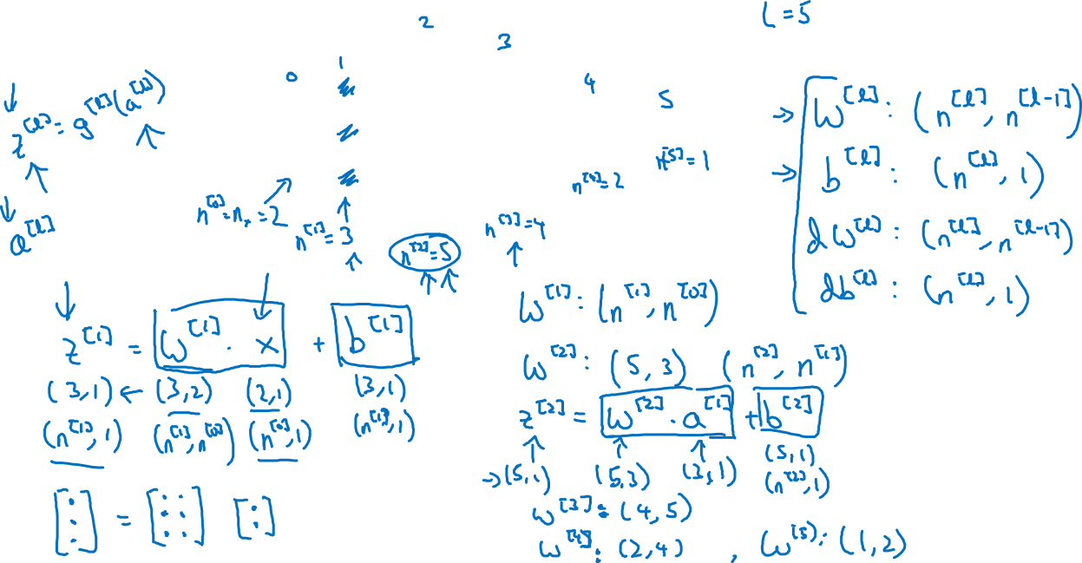



Parameters $W^{[l]}$ and $b^{[l]}$
$$x_{1}$$
$$\hat{y}$$
$$x_{2}$$

Slide 3
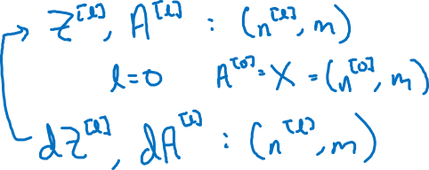
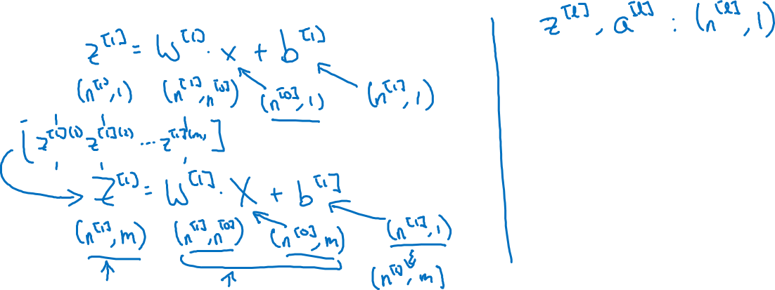
Vectorized implementation
$$x_{1}$$
$$\hat{y}$$
$$x_{2}$$

